Slide 1

Flask Backend Development Project

Slide 2
About me
I am currently pursuing M.Sc in Statistics, Osmania University
I have a huge interest in the field of Data Science
LinkedIn Profile URL :https://www.linkedin.com/in/manichandana-Sheela/
GitHub Profile URL : https://github.com/MANICHANDANA2

Slide 3
Technologies Used
Front End
Back End
HTML
CSS
Bootstrap
Python
Regex
Flask

Slide 4
STEP - 1
Create a new directory for your project and navigate into it
STEP - 2
Set up your virtual development environment:
Install Flask , a python web framework , using pip if not already installed. ‘pip install Flask’

Slide 5
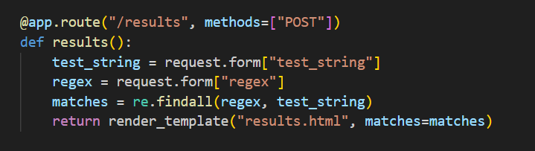
STEP - 3
Initialize a new Flask application
Create a new python file named app.py
Import Flask and create a new Flask app instance.
Define a route for the homepage(“/”) where users can input the test string and regex
Render an HTML template containing a form with fields for the test string and regex , and a submit button

Slide 6
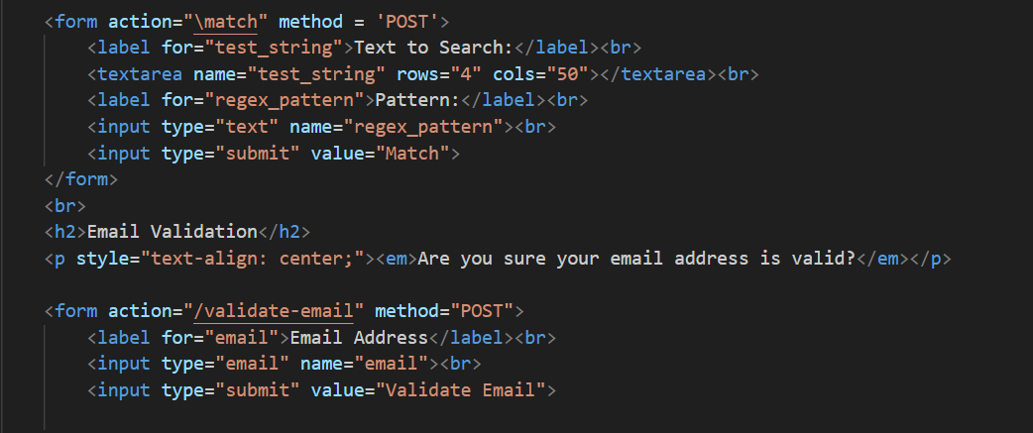
STEP - 4
Create the HTML template:
Create a new directory names ‘templates’ within your project directory
Inside the ‘templated’ directory, Create a new HTML file named ‘index.html’
Design the HTML form with input fields for the text string and regex , and a submit button

Slide 7
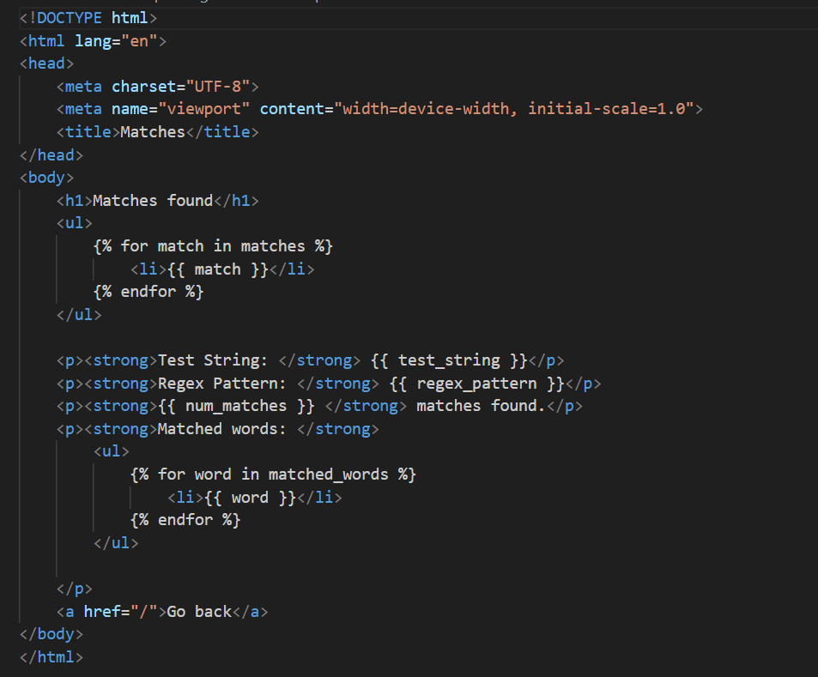
STEP - 5
Create the HTML template:
Create a new directory names ‘templates’ within your project directory
Inside the ‘templated’ directory, Create a new HTML file named ‘matches.html’
Design the HTML form with input fields for the text string and regex , and a submit button

Slide 8
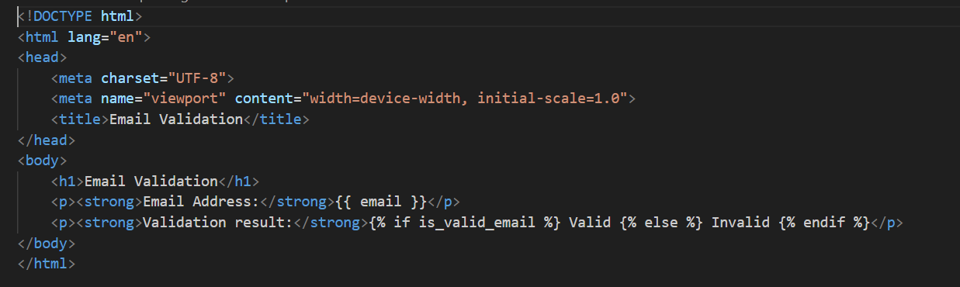
STEP - 6
Render the results:
Pass the list of matched strings to the HTML template.
Modify the HTML template to display the matched strings below the input form

Slide 9
STEP - 7
Test your application
Run your flask application
Open a Web browser and navigate
Input various test strings and regex pattern to ensure the application displays the correct matches

Slide 10
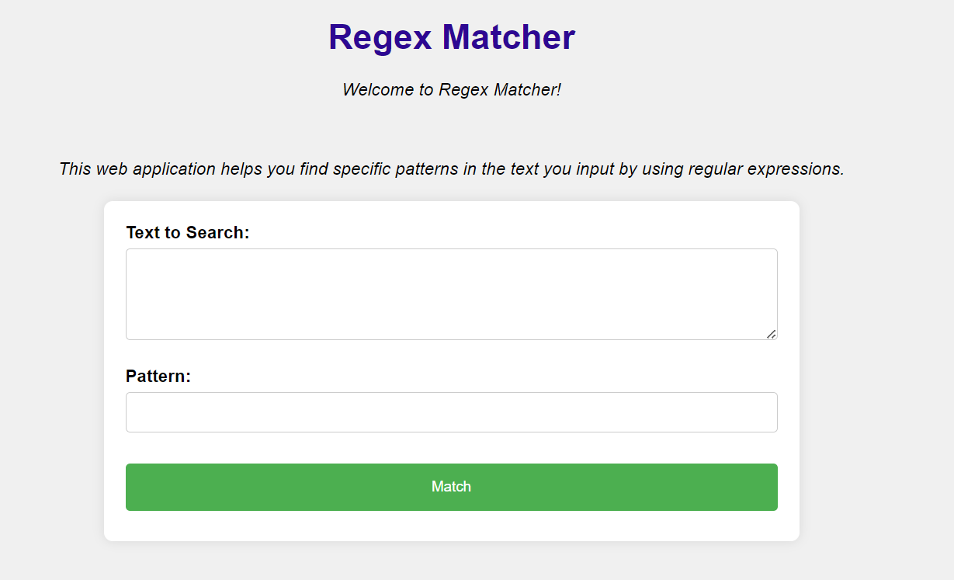
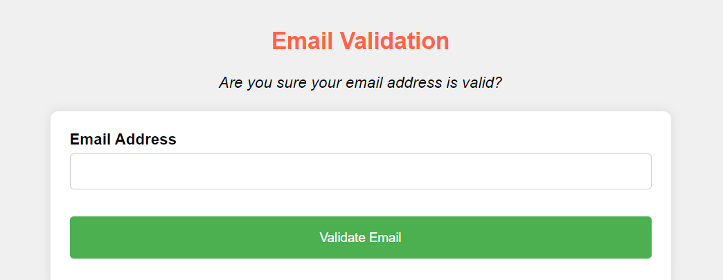

Slide 11

THANK YOU

